Slide 1
TEXT MINING
MIS 612 - 675
GROUP 4

Slide 2
TABLE OF CONTENTS
01
02
03
INSTALLATION OF R PACKAGES
04
DATA TRANSFORMATION
TEXT
ANALYSIS
TEXT
VISUALIZATION
Load packages
Import data
Create Corpus
Data Pre-processing
Tokenizing by BI-gram
Document Text Matrix
Term frequency statistic and term correlation
Bar plot
Word Cloud
Notes:
Overall, we have 4 main steps to process in our text-mining project.
First of all, it’s required R packages to install from CRAN and loading before importing the data.
In this project, we used an employee response dataset that included a text column in it.
Once we loaded the data, we started data pre-processing which includes the functionality of
1.Remove punctuations
2.Stop words
3.Remove words spacing
4.Stemming words
5.Standardize for lower case letter
6.Spelling replacement etc
We also utilized tokenization based on Bi-gram words which is a more intuitive way to see rather than a single-word method.
After the transformation process started we start analyzing our word terms such as frequency terms, finding out their words associated, and terms statistics.
In our last step, visualize to see the analysis result in bar plots and word cloud.

Slide 3
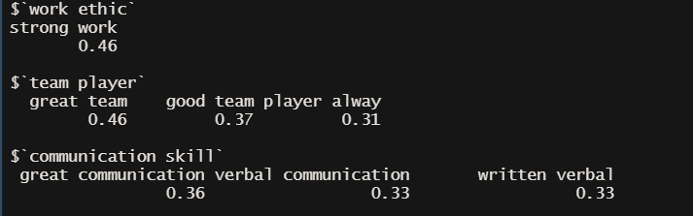
DATA TRANSFORMATION
1
STEP 1: Create a corpus to put the dataset
2
STEP 2: Tokenization and cleaning of the uninformative dataset using tm_map()
STEP 3: Create a Document text matrix using bigrams to tokenize 2-grams terms and order by most frequency terms.
3
4
STEP 4: Explore the most frequent terms and their correlations
Work ethic is 46% associated to the term “strong work”.
Team player is also associated to 3 different terms 46%, 37%, and 31% accordingly.
Communication skill is associated with the term, great communication, verbal communication, and written verbal
Notes:
In our data transformation process, we used text mining functions such as corpus, document term matrix, tokenization, and term-document matrix
In Corpus, it basically represents a dimensional vector and it does store a unique number of terms in the corpus vector.
Document term matrix (DTM) is converted corpus terms vector into matrix format and column sum the frequency terms. Its also part of Bigram tokenization functions in document term matrix
Then after that, we explore the data in the most associated terms that you can see on the slide.
For instance, the terms called “work ethic” which is 46% correlated to other terms “strong work”.
Another slide will explore clean text data for further analysis.

Slide 4
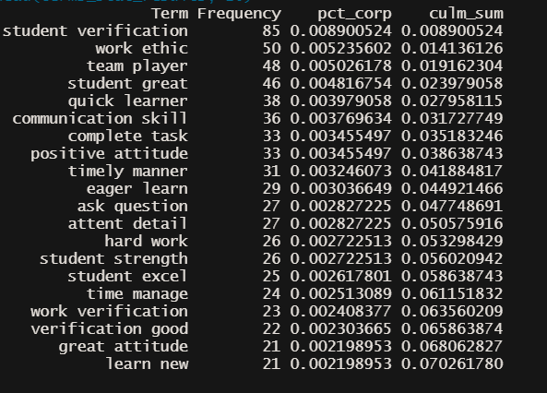
TEXT ANALYSIS
According to bi-grams text analysis, the last 4 most frequent terms make up almost 7% of the total terms.
1
Team manage
2
Work verification
3
Great attitude
4
Learn new
Notes:
As we used the employee response spreadsheet dataset, we found some relevant information that employees positive reviewed to the students in this survey.
We can frequently see the terms “Great attitude, Team manage, Learn new, work verification” etc. This can be an efficient and effectiveness way of decision-making through text mining data.
Potential issued in our analysis
1. In preprocessing stage, sometimes word meaning can be alteration while we use stemming the words.
2. It may create ambiguous in meaning and lead to negative results.

Slide 5
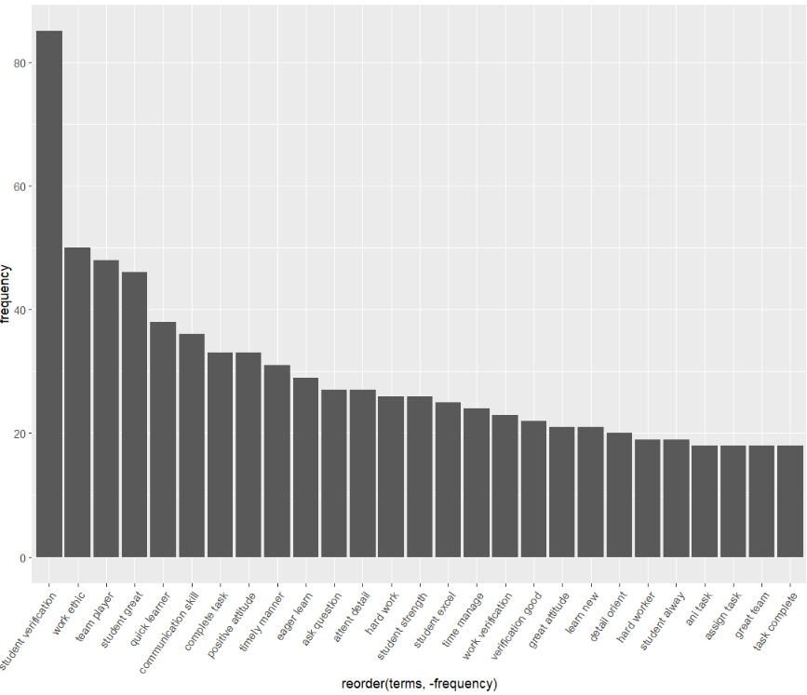
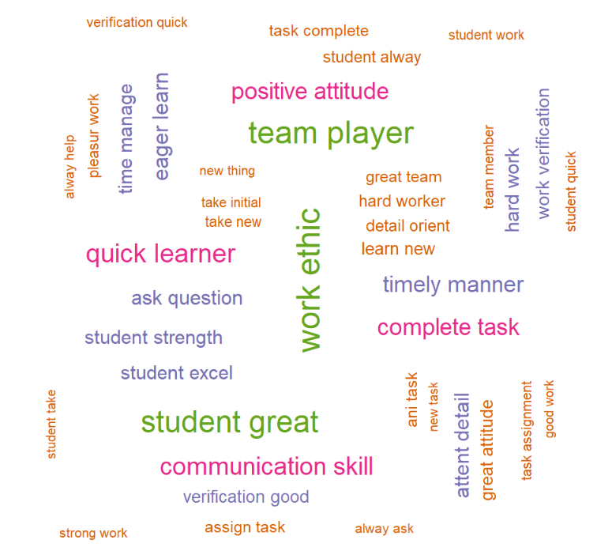
TEXT VISUALIZATION
Word cloud for frequency terms
Bar plot for frequency terms
Notes:
From previous slide, This is for visualization to enhance our analysis.
A bar plot to show most frequent terms from left to right.
Word cloud present scatter of terms and most frequency will display as bigger display. (i.e, work ethic, team player, positive attitude etc)

Slide 6
REFERENCES
Anandarajan, M., Hill, C., & Nolan, T. (2019). Practical Text Analytics. In Advances in Analytics and Data Science. Springer International Publishing. https://doi.org/10.1007/978-3-319-95663-3
Girdher, H. (2021, July 30). TDM (Term Document Matrix) and DTM (Document Term Matrix). Analytics Vidhya. https://medium.com/analytics-vidhya/tdm-term-document-matrix-and-dtm-document-term-matrix-8b07c58957e2
Hutson, G. (2021, March 17). Text Mining – Term Frequency analysis and Word Cloud creation using the tm package | R-bloggers. https://www.r-bloggers.com/2021/03/text-mining-term-frequency-analysis-and-word-cloud-creation-using-the-tm-package/
Kirenz, J. (2019, September 16). Text Mining in R. Jan Kirenz. https://www.kirenz.com/post/2019-09-16-r-text-mining/
Lonkar, S. (2019, January 28). Text Mining in Data Science. Text Mining in Data Science— a Tutorial of Text Mining in R Using TM Package. https://medium.com/text-mining-in-data-science-a-tutorial-of-text/text-mining-in-data-science-51299e4e594

